Slide 1
A randomized comparison of the efficacy, safety, and cost between single-dose etoposide (375 mg/m2 for 1 day) and risk-adapted plerixafor + G-CSF mobilization in multiple myeloma patients
Department of Hematology, Eunpyeong St. Mary’s Hospital, The Catholic University of Korea, Seoul, Korea
Shin Seung-Hwan, M.D., Ph. D.

Slide 2
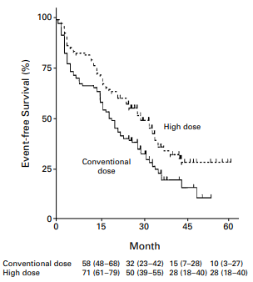
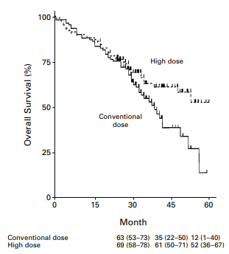
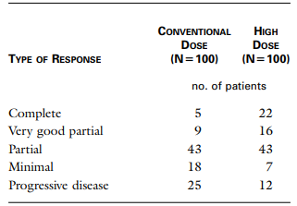
Introduction
High-dose chemotherapy followed by autologous stem cell transplantation (ASCT) – a mainstay of treatment for newly diagnosed, eligible patients with MM
In the era of pre-novel agents, a randomized trial by Intergroupe Français du Myélome
N Engl J Med. 1996 Jul 11;335(2):91-7.

Slide 3
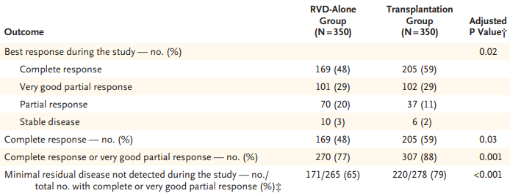
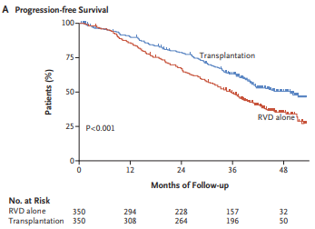
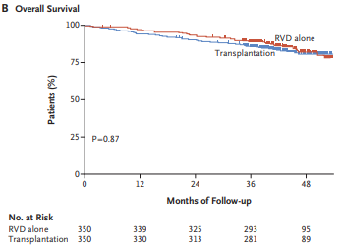
Introduction
High-dose chemotherapy followed by autologous stem cell transplantation (ASCT) – a mainstay of treatment for newly diagnosed, eligible patients with MM
N Engl J Med. 2017 Apr 6;376(14):1311-1320.

Slide 4
Introduction
Collection of enough amounts of CD34+ hematopoietic stem cells (HSC) – important for successful engraftment and avoidance of transplant-related complications
CD34+ cell dose of < 1.0 × 10⁶/kg – increased RBC transfusion requirements and even permanent loss of engraftment
CD34+ cell dose of 1.5 – 2.5 × 10⁶/kg – delayed neutrophil and platelet recovery (minimum recommended cell)
CD34+ cell dose of < 3.0 – 5.0 × 10⁶/kg – earlier neutrophil and platelet engraftment (optimal CD 34+ cell does)
CD34+ cell dose of > 6.0 × 10⁶/kg – improved long-term platelet recovery and reduced blood transfusion requirements, although there was no significant difference in time to platelet recovery
Biol Blood Marrow Transplant. 2014 Mar;20(3):295-308.

Slide 5
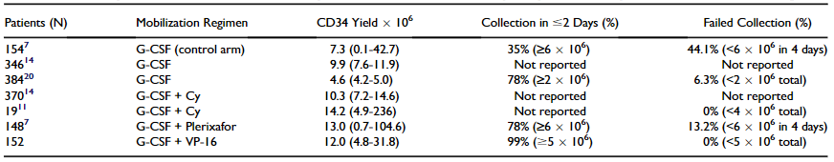
Introduction
Most used approaches to stem cell collection – G-CSF alone and CY mobilization
Recently published mobilization efficacy rates in patients with multiple myeloma
Risk Factors Associated with Poor Mobilization
Baseline | At time of mobilization
Treatment-related Numerous cycles of previous chemotherapy Previous exposure to melphalan, fludarabine, platinum-containing regimens, alkylating agents, or lenalidomide Previous radiation therapy to the bone marrow Patient-related Advanced age Diagnosis of Non-Hodgkin’s lymphoma Diabetes Bone marrow-related Bone marrow involvement Thrombocytopenia | Low steady-state PB CD34+ cell count Steady-state thrombocytopenia Low pre-apheresis PB CD34þ cell count Low day 1 apheresis yield
Biol Blood Marrow Transplant. 2014 Mar;20(3):295-308.

Slide 6
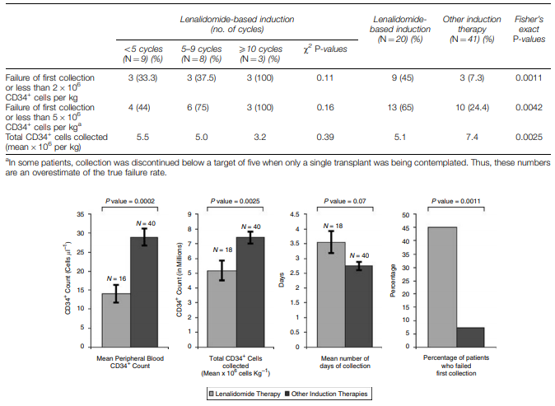
Introduction
Compromised stem cell mobilization following induction therapy with lenalidomide
Leukemia. 2008 Jun;22(6):1282-4.

Slide 7
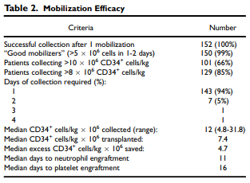
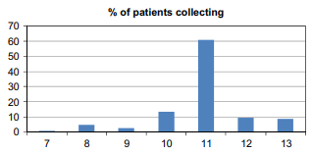
Introduction
Chemomobilization with intermediate-dose etoposide (375 mg/m² for 2 days)
Neutropenia – 105 (78.9%) patients
Hospitalization for fever – 22 (14.0%) patients
Outpatient antibiotics administration – 4 (3.0%) patients
PRC and platelet transfusion – 24 (16.0%) patients and 9 (6.0%) patients, respectively
Percentage of patients collecting on days 7 – 13 from start of mobilization
Mobilization Efficacy
Biol Blood Marrow Transplant. 2011 Jan;17(1):141-6.

Slide 8
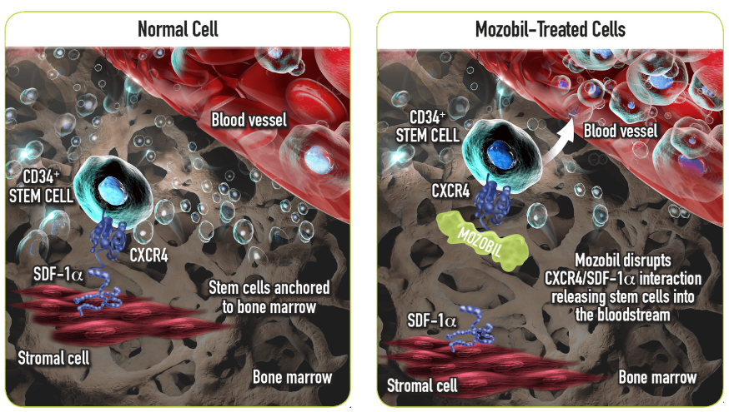
Introduction
Plerixafor and G-CSF versus placebo and G-CSF to mobilize hematopoietic stem cells for autologous stem cell transplantation in patients with multiple myeloma
Blood. 2009 Jun 4;113(23):5720-6.

Slide 9
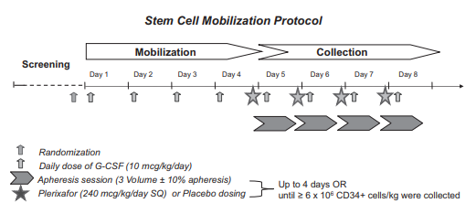
Introduction
Plerixafor (Mozobil®) and G-CSF versus placebo and G-CSF to mobilize hematopoietic stem cells for autologous stem cell transplantation in patients with multiple myeloma
A phase 3, multicenter, randomized, double-blind, placebo-controlled study for evaluating the efficacy and safety of Plerixafor (0.24 mg/kg) + G-CSF (10 μg/kg) vs placebo + G-CSF (10 μg/kg) in 302 patients with multiple myeloma
Blood. 2009 Jun 4;113(23):5720-6.

Slide 10
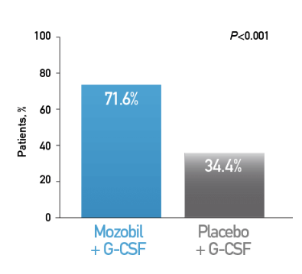
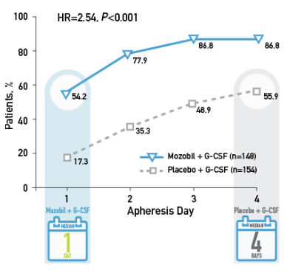
Introduction
Plerixafor (Mozobil®) and G-CSF versus placebo and G-CSF to mobilize hematopoietic stem cells for autologous stem cell transplantation in patients with multiple myeloma
Primary end point – Percentage of patients with MM who Achieved ≥ 6 x 10⁶ CD34+ cells/kg in two or fewer days of apheresis
Secondary end point - Kaplan-Meier estimate of the proportion of patients with MM who achieved ≥ 6 x 10⁶ CD34+ cells/kg
Blood. 2009 Jun 4;113(23):5720-6.

Slide 11
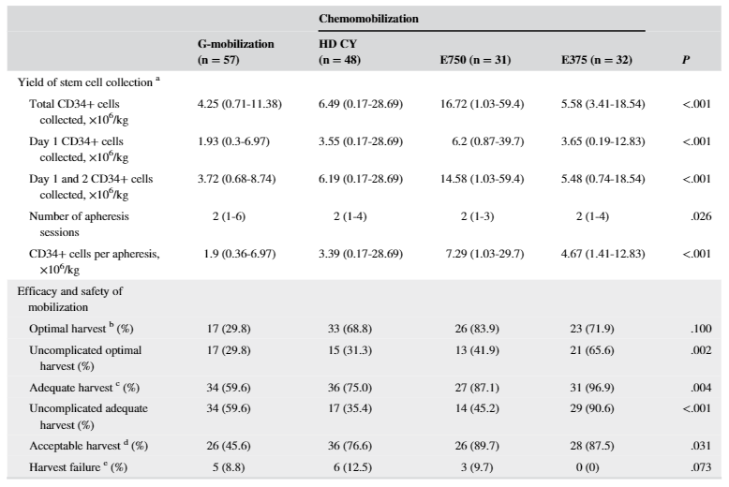
Single-dose etoposide mobilization in autologous SC mobilization for MM patients
Comparison of mobilization outcomes of G-CSF, HD CY (3.5 g/m²), and single-dose (E375; 375 mg/m² for 1 day) and intermediate-dose (E750; 375 mg/m² for 2 days) etoposide
J Clin Apher. 2019 Oct;34(5):579-588.

Slide 12
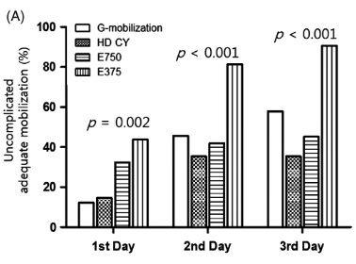
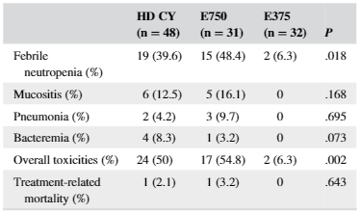
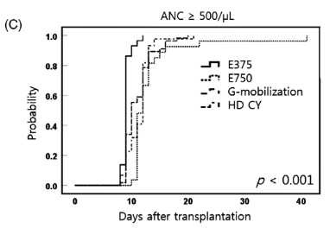
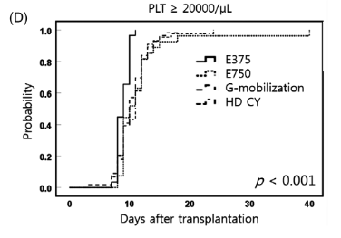
Single-dose etoposide mobilization in autologous SC mobilization for MM patients
Comparison of grade 3–4 toxicities according to mobilization methods
Cumulative percentages of uncomplicated adequate harvest for each mobilization method according to each day of apheresis
Kaplan-Meier curve for neutrophil engraftment after ASCT
Kaplan-Meier curve for platelet engraftment after ASCT
J Clin Apher. 2019 Oct;34(5):579-588.

Slide 13
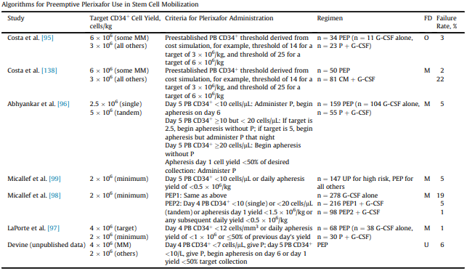
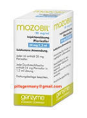
Introduction
Risk-adapted Plerixafor administration strategies
$ 6630 / 1 vial
Biol Blood Marrow Transplant. 2014 Mar;20(3):295-308.

Slide 14
G-CSF + patient-adapted plerixafor vs CY mobilization in autologous SC mobilization
A retrospective study of 50 MA and 81 CY cohort patients
Mobilization completion rate of the MA and the CY cohorts – 98% (95% CI, 94.1 – 100) vs 77.8% (95% CI, 68.7 – 87.8) (P < 0.01)
Median yield of CD34 + cells of the MA and the CY cohorts – 7.0 × 10⁶/kg (IQR, 4.2 – 9.9) vs 7.7 × 10⁶/kg (IQR, 5.0 – 12.7) (P = 0.08)
Bone Marrow Transplant. 2011 Apr;46(4):523-8.

Slide 15
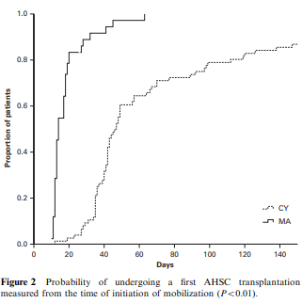
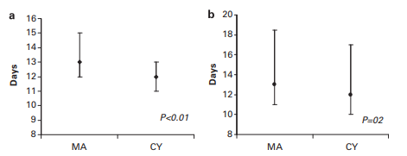
G-CSF + patient-adapted plerixafor vs CY mobilization in autologous SC mobilization
Hospitalization during mobilization of the MA and the CY cohorts –2.0% (95% CI, 0.0 – 5.9) vs 30.0% (95% CI, 19.7 – 39.6) (P < 0.01)
Neutropenic fever of the MA and the CY cohorts – 6.2% (95% CI, 0.9 – 11.4) vs 26.0% (95% CI, 16.4 – 35.5)
Cost of mobilization of the MA and the CY cohorts - US$ 23,893.28 vs US$ 29,423.31
Mobilization to transplantation time of the MA and the CY cohorts – 14 days (IQR, 12 – 18) vs 43 days (IQR, 36 – 67) (P < 0.01)
Neutrophil engraftment of the MA and the CY cohorts – 13 days vs 12 days (P < 0.01)
Platelet engraftment of the MA and the CY cohorts – 13 days vs 12 days (P < 0.20)
Bone Marrow Transplant. 2011 Apr;46(4):523-8.

Slide 16
Proposal
A phase III study of single-dose etoposide vs G-CSF + patient-adapted plerixafor in patients with MM

Slide 17
Proposal
Inclusion criteria
Multiple myeloma patients of age < 70 years
≥ PR response (IMWG response criteria) by induction regimens containing novel agents (proteasome inhibitors and/or immunomodulator drugs)
Adequate organ functions adequate for autologous transplantation
Exclusion criteria
Diseases monoclonal gammopathy other than multiple myeloma (including amyloidosis and POEMS syndrome)
Prior other solid or hematologic malignancies

Slide 18
Proposal
Primary and points
Optimal harvest rates between the single-dose etoposide and the G-CSF + patient-adapted plerixafor groups
Efficacy of harvest
Optimal harvest – collected CD34+ cell dose ≥ 6 × 10⁶/kg (may be enough for tandem ASCT)
Acceptable harvest – collected CD34+ cell dose ≥ 3 × 10⁶/kg (may be enough for single ASCT)
Harvest failure – collected CD34 + cell dose < 2 × 10⁶/kg
Adverse events
Major complications – grade III-IV hematologic and non-hematologic toxicities requiring admission (febrile neutropenia, bacteremia, and pneumonia, etc.)

Slide 19
Proposal
Adverse events
Adverse events – evaluated and graded according to Common Terminology Criteria for Adverse Events (CTCAE) version 4.0
Cost analysis

Slide 20
Thank you for your attention!

